Slide 1
SYSTEM PROGRAMMING LECTURE
Lecturer Izazullah
GPGC Charsadda

Slide 2
Portable Executable
PE stands for Portable Executable, it’s a file format for executables used in Windows operating systems, it’s based on the COFF file format (Common Object File Format).
Not only .exe files are PE files, dynamic link libraries (.dll), Kernel modules (.srv), Control panel applications (.cpl) and many others are also PE files.
A PE file is a data structure that holds information necessary for the OS loader to be able to load that executable into memory and execute it.

Slide 3
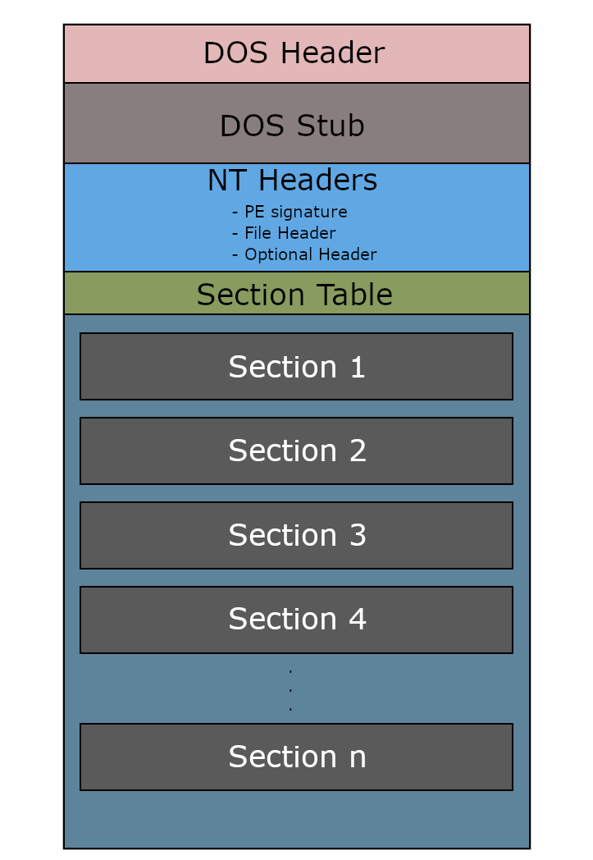
Portable Executable
Structure Overview:
A typical PE file follows the structure outlined in the following figure:

Slide 4
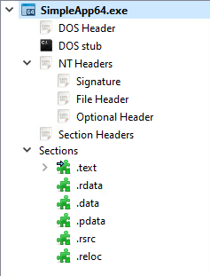
Portable Executable
If we open an executable file with PE-bear we’ll see the same thing.

Slide 5
Portable Executable
DOS Header:
The DOS header (also called the MS-DOS header) is a 64-byte-long structure that exists at the start of the PE file.
it’s not important for the functionality of PE files on modern Windows systems, however it’s there because of backward compatibility reasons.
This header makes the file an MS-DOS executable, so when it’s loaded on MS-DOS the DOS stub gets executed instead of the actual program.
Without this header, if you attempt to load the executable on MS-DOS it will not be loaded and will just produce a generic error.

Slide 6
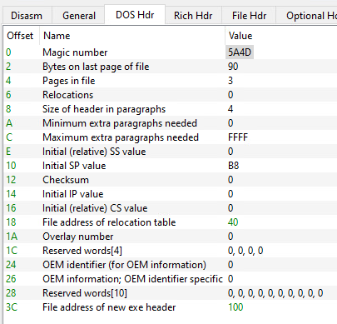
Portable Executable
Structure:
As mentioned before, it’s a 64-byte-long structure, we can take a look at the contents of that structure by looking at the IMAGE_DOS_HEADER structure definition from winnt.h:

Slide 7
Portable Executable
This structure is important to the PE loader on MS-DOS, however only a few members of it are important to the PE loader on Windows Systems, so we’re not going to cover everything in here, just the important members of the structure.
e_magic: This is the first member of the DOS Header, it’s a WORD so it occupies 2 bytes, it’s usually called the magic number. It has a fixed value of 0x5A4D or MZ in ASCII, and it serves as a signature that marks the file as an MS-DOS executable.
e_lfanew: This is the last member of the DOS header structure, it’s located at offset 0x3C into the DOS header and it holds an offset to the start of the NT headers. This member is important to the PE loader on Windows systems because it tells the loader where to look for the file header.

Slide 8
Portable Executable
The following picture shows contents of the DOS header in an actual PE file using PE-bear:
As you can see, the first member of the header is the magic number with the fixed value we talked about which was 5A4D.
The last member of the header (at offset 0x3C)
is given the name
“File address of new exe header”.
it has the value 100,
we can follow to that offset
and we’ll find the start of the
NT headers as expected:

Slide 9
Portable Executable
DOS STUB:
The DOS stub is an MS-DOS program that prints an error message saying that the executable is not compatible with DOS then exits.
This is what gets executed when the program is loaded in MS-DOS, the default error message is “This program cannot be run in DOS mode.”, however this message can be changed by the user during compile time.

Slide 10
Portable Executable
NT Headers (IMAGE_NT_HEADERS):
NT headers is a structure defined in winnt.h as IMAGE_NT_HEADERS, by looking at its definition we can see that it has three members, a DWORD signature, an IMAGE_FILE_HEADER structure called File Header and an IMAGE_OPTIONAL_HEADER structure called Optional Header.
It’s worth mentioning that this structure is defined in two different versions, one for 32-bit executables (Also named PE32 executables) named IMAGE_NT_HEADERS and one for 64-bit executables (Also named PE32+ executables) named IMAGE_NT_HEADERS64.
The main difference between the two versions is the used version of IMAGE_OPTIONAL_HEADER structure which has two versions, IMAGE_OPTIONAL_HEADER32 for 32-bit executables and IMAGE_OPTIONAL_HEADER64 for 64-bit executables.

Slide 11
Portable Executable
Signature:
First member of the NT headers structure is the PE signature, it’s a DWORD which means that it occupies 4 bytes.
It always has a fixed value of 0x50450000 which translates to PE\0\0 in ASCII.
Here’s a screenshot from PE-bear showing the PE signature:

Slide 12
Portable Executable
File Header (IMAGE_FILE_HEADER):
Also called “The COFF File Header”, the File Header is a structure that holds some information about the PE file.
It’s defined as IMAGE_FILE_HEADER in winnt.h, here’s the definition:
typedef struct _IMAGE_FILE_HEADER {
WORD Machine;
WORD NumberOfSections;
DWORD TimeDateStamp;
DWORD PointerToSymbolTable;
DWORD NumberOfSymbols;
WORD SizeOfOptionalHeader;
WORD Characteristics;
} IMAGE_FILE_HEADER, *PIMAGE_FILE_HEADER;

Slide 13
Portable Executable
Machine: This is a number that indicates the type of machine (CPU Architecture) the executable is targeting, this field can have a lot of values, but we’re only interested in two of them, 0x8864 for AMD64 and 0x14c for i386.
NumberOfSections: This field holds the number of sections (or the number of section headers aka. the size of the section table.).
TimeDateStamp: A unix timestamp that indicates when the file was created.
PointerToSymbolTable and NumberOfSymbols: These two fields hold the file offset to the COFF symbol table and the number of entries in that symbol table, however they get set to 0 which means that no COFF symbol table is present, this is done because the COFF debugging information is deprecated.
SizeOfOptionalHeader: The size of the Optional Header.
Characteristics: A flag that indicates the attributes of the file, these attributes can be things like the file being executable, the file being a system file and not a user program, and a lot of other things.

Slide 14
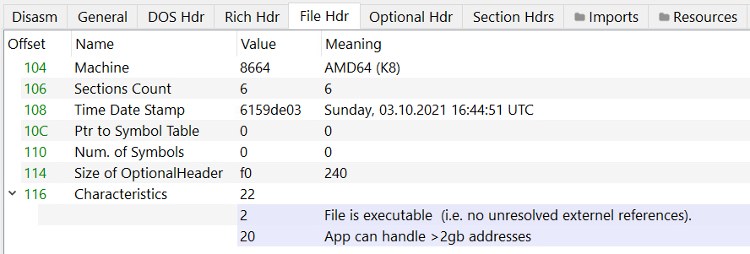
Portable Executable
Here’s the File Header contents of an actual PE file:

Slide 15
Portable Executable
Optional Header (IMAGE_OPTIONAL_HEADER):
The Optional Header is the most important header of the NT headers, the PE loader looks for specific information provided by that header to be able to load and run the executable.
It’s called the optional header because some file types like object files don’t have it, however this header is essential for image files.
It doesn’t have a fixed size, that’s why the IMAGE_FILE_HEADER.SizeOfOptionalHeader member exists.
The first 8 members of the Optional Header structure are standard for every implementation of the COFF file format, the rest of the header is an extension to the standard COFF optional header defined by Microsoft, these additional members of the structure are needed by the Windows PE loader and linker.
As mentioned earlier, there are two versions of the Optional Header, one for 32-bit executables and one for 64-bit executables.

Slide 16
Portable Executable
The two versions are different in two aspects
The size of the structure itself (or the number of members defined within the structure): IMAGE_OPTIONAL_HEADER32 has 31 members while IMAGE_OPTIONAL_HEADER64 only has 30 members, that additional member in the 32-bit version is a DWORD named BaseOfData which holds an RVA of the beginning of the data section.
The data type of some of the members: The following 5 members of the Optional Header structure are defined as DWORD in the 32-bit version and as ULONGLONG in the 64-bit version:
ImageBase
SizeOfStackReserve
SizeOfStackCommit
SizeOfHeapReserve
SizeOfHeapCommit

Slide 17
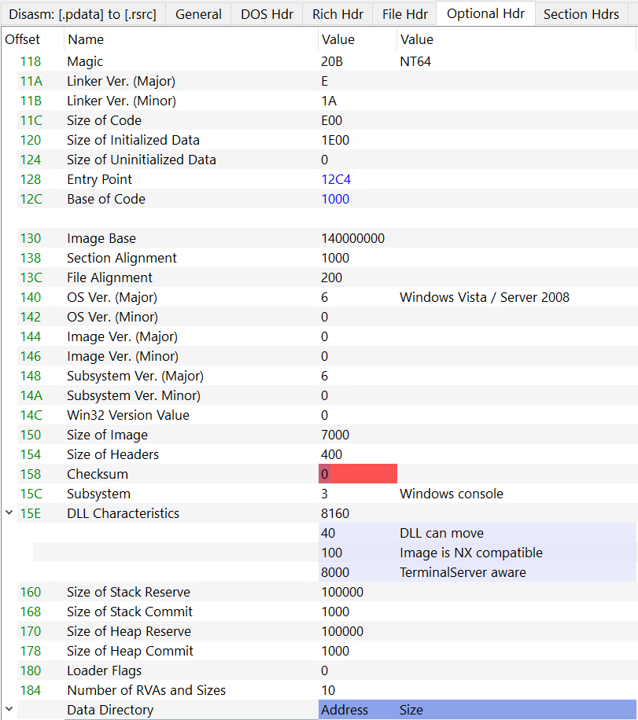
Portable Executable

Slide 18
Portable Executable
Data Directories:
The last member of the IMAGE_OPTIONAL_HEADER structure was an array of IMAGE_DATA_DIRECTORY structures defined as follows:
IMAGE_DATA_DIRECTORY DataDirectory[IMAGE_NUMBEROF_DIRECTORY_ENTRIES];
IMAGE_NUMBEROF_DIRECTORY_ENTRIES is a constant defined with the value 16, meaning that this array can have up to 16 IMAGE_DATA_DIRECTORY entries:
#define IMAGE_NUMBEROF_DIRECTORY_ENTRIES 16
An IMAGE_DATA_DIRETORY structure is defines as follows:
typedef struct _IMAGE_DATA_DIRECTORY {
DWORD VirtualAddress;
DWORD Size;
} IMAGE_DATA_DIRECTORY, *PIMAGE_DATA_DIRECTORY;

Slide 19
Portable Executable
It’s a very simple structure with only two members, first one being an RVA pointing to the start of the Data Directory and the second one being the size of the Data Directory.
So what is a Data Directory? Basically a Data Directory is a piece of data located within one of the sections of the PE file.
Data Directories contain useful information needed by the loader, an example of a very important directory is the Import Directory which contains a list of external functions imported from other libraries.
Please note that not all Data Directories have the same structure, the IMAGE_DATA_DIRECTORY.VirtualAddress points to the Data Directory, however the type of that directory is what determines how that chunk of data is going to be parsed.
Here’s a list of Data Directories defined in winnt.h. (Each one of these values represents an index in the DataDirectory array):

Slide 20
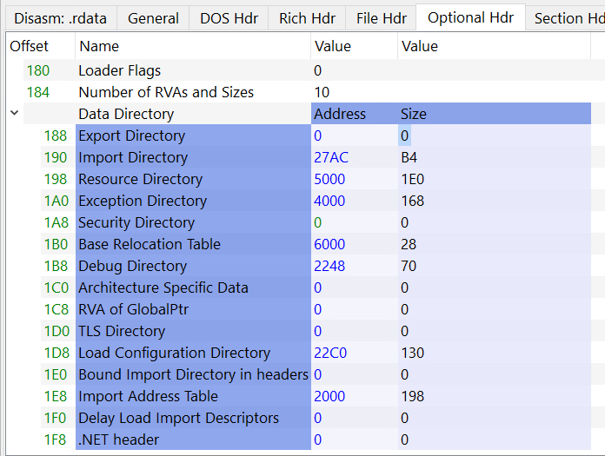
Portable Executable
If we take a look at the contents of IMAGE_OPTIONAL_HEADER.DataDirectory
of an actual PE file, we might see
entries where both fields are set to 0:
This means that this specific Data Directory
is not used (doesn’t exist) in the executable file.

Slide 21
Portable Executable
Sections and Section Headers:
Sections:
Sections are the containers of the actual data of the executable file, they occupy the rest of the PE file after the headers, precisely after the section headers.
Some sections have special names that indicate their purpose, we’ll go over some of them.
.text: Contains the executable code of the program.
.data: Contains the initialized data.
.bss: Contains uninitialized data.
.rdata: Contains read-only initialized data.
.edata: Contains the export tables.
.idata: Contains the import tables.
.reloc: Contains image relocation information.
.rsrc: Contains resources used by the program, these include images, icons or even embedded binaries.
.tls: (Thread Local Storage), provides storage for every executing thread of the program.

Slide 22
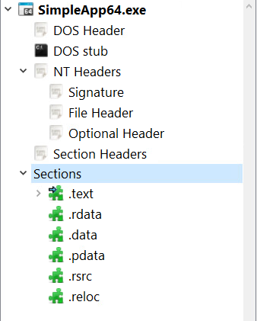
Portable Executable
Section in PE-BEAR

Slide 23
Portable Executable
Section Headers:
After the Optional Header and before the sections comes the Section Headers. These headers contain information about the sections of the PE file.
A Section Header is a structure named IMAGE_SECTION_HEADER defined in winnt.h as follows:

Slide 24
Portable Executable
typedef struct _IMAGE_SECTION_HEADER {
BYTE Name[IMAGE_SIZEOF_SHORT_NAME];
union {
DWORD PhysicalAddress;
DWORD VirtualSize;
} Misc;
DWORD VirtualAddress;
DWORD SizeOfRawData;
DWORD PointerToRawData;
DWORD PointerToRelocations;
DWORD PointerToLinenumbers;
WORD NumberOfRelocations;
WORD NumberOfLinenumbers;
DWORD Characteristics;
} IMAGE_SECTION_HEADER, *PIMAGE_SECTION_HEADER;

Slide 25
Portable Executable
Relocations:
When a program is compiled, the compiler assumes that the executable is going to be loaded at a certain base address, that address is saved in IMAGE_OPTIONAL_HEADER.ImageBase, some addresses get calculated then hardcoded within the executable based on the base address.
However for a variety of reasons, it’s not very likely that the executable is going to get its desired base address, it will get loaded in another base address and that will make all of the hardcoded addresses invalid.
A list of all hardcoded values that will need fixing if the image is loaded at a different base address is saved in a special table called the Relocation Table (a Data Directory within the .reloc section). The process of relocating (done by the loader) is what fixes these values.

Slide 26
Portable Executable
Let’s take an example, the following code defines an int variable and a pointer to that variable:
int test = 2;
int* testPtr = &test;
During compile-time, the compiler will assume a base address, let’s say it assumes a base address of 0x1000, it decides that test will be located at an offset of 0x100 and based on that it gives testPtr a value of 0x1100.
Later on, a user runs the program and the image gets loaded into memory.
It gets a base address of 0x2000, this means that the hardcoded value of testPtr will be invalid, the loader fixes that value by adding the difference between the assumed base address and the actual base address, in this case it’s a difference of 0x1000 (0x2000 - 0x1000), so the new value of testPtr will be 0x2100 which is the correct new address of test.

Slide 27
Portable Executable
Relocation Table:
As described by Microsoft documentation, the base relocation table contains entries for all base relocations in the image.
It’s a Data Directory located within the .reloc section, it’s divided into blocks, each block represents the base relocations for a 4K page and each block must start on a 32-bit boundary.
Each block starts with an IMAGE_BASE_RELOCATION structure followed by any number of offset field entries.
The IMAGE_BASE_RELOCATION structure specifies the page RVA, and the size of the relocation block.

Slide 28
Portable Executable
typedef struct _IMAGE_BASE_RELOCATION {
DWORD VirtualAddress;
DWORD SizeOfBlock;
} IMAGE_BASE_RELOCATION;
typedef IMAGE_BASE_RELOCATION UNALIGNED * PIMAGE_BASE_RELOCATION;
Each offset field entry is a WORD, first 4 bits of it define the relocation type, the last 12 bits store an offset from the RVA specified in the IMAGE_BASE_RELOCATION structure at the start of the relocation block.

Slide 29
THANK YOU

